Slide 1
Instrumentation
J. G. Weisend II
www.europeanspallationsource.se
Winter 2025

Slide 2
Goals
Describe measurements & instrumentation in cryogenic systems
Give examples of typical temperature, pressure, flow and level sensors used in cryogenic systems
Discuss the proper installation of sensors, wiring and feed throughs in cryogenic instrumentation
Describe Thermal Acoustic Oscillations

Slide 3
Introduction
The correct measurement of properties such as temperature, pressure, flow, level and vacuum in cryogenic systems is a key factor in the success of cryogenic systems.
Measurements will allow us to understand if our cryogenic components are working properly, enable us to control them and permit the collection of scientific data.
There are many subtleties in the selection and installation of cryogenic sensors.
  Poor sensor selection and installation can result in wildly inaccurate readings or sensor failure
Think about instrumentation as a complete system – sensor, wiring, feed through, DAQ rather than just the sensor itself.
  Total system cost per measuring point can be ~ $500 - $1000

Slide 4
Introduction
Define system & sensor requirements:
  Range
  Accuracy
  Time response
  Sensor environment (e.g. presence of magnetic or radiation fields)
  Precision – what is the smallest change detected by the sensor?
  Reliability
  Cost

Slide 5
Instrumentation Rules of Thumb
Don’t use more accuracy & precision than required
Use commercially produced sensors whenever possible – there is a lot available
When possible, mount sensors outside cryostat at 300 K (e.g. pressure transducers, flow meters)
For critical devices inside of cryostats, install redundant sensors whenever feasible
Be sure to consider how to recalibrate sensors
If at all possible avoid, cold instrumentation feed throughs
  SNS experience
Once R&D is done, minimize number of sensors in series production of cryostats

Slide 6
Temperature Measurement
Measure some property – typically resistance or voltage drop that changes with temperature
Commercial Temperature Sensing Options
  Silicon Diodes ( 300 K - ~1 K)
  Pt Resistors (300 K - ~ 30 K)
  Ge Resistors (100 K < 1 K)
  Carbon Glass resistors (300 K ~ 1 K) best below 100 K
  Ruthenium Oxide (40 K - < 1 K )
  Cernox (300 K < 1 K)
  Thermocouples
Take care not to put so much power in the sensor that it “self heats” and gives a false reading. Follow the vendor’s recomendations

Slide 7
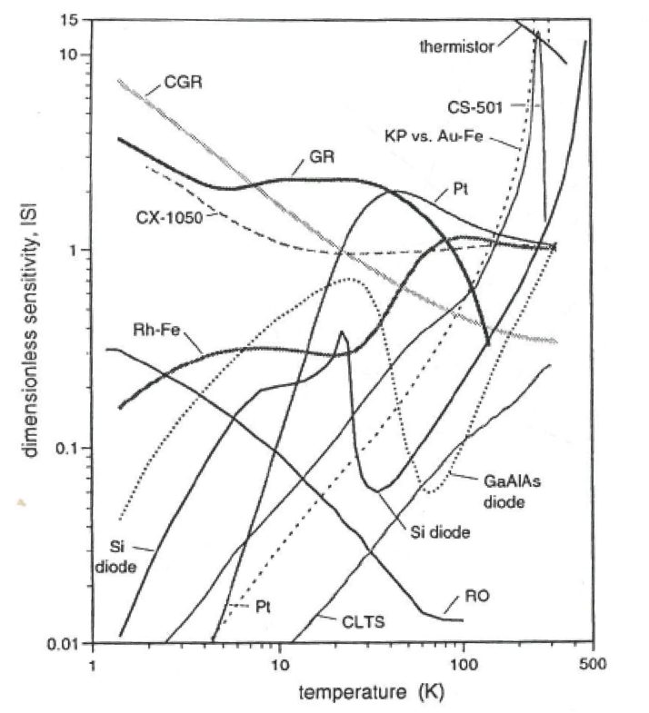
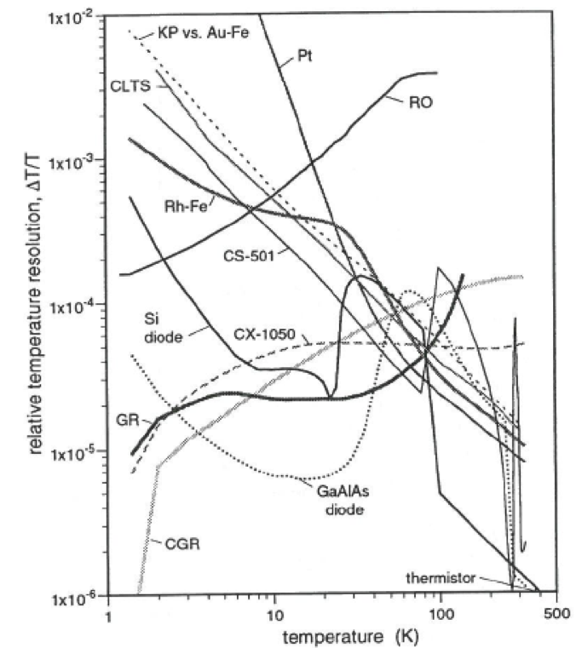
Typical Cryogenic Temperature Sensor Characteristics
(from LakeShore Cryotronics)

Slide 8
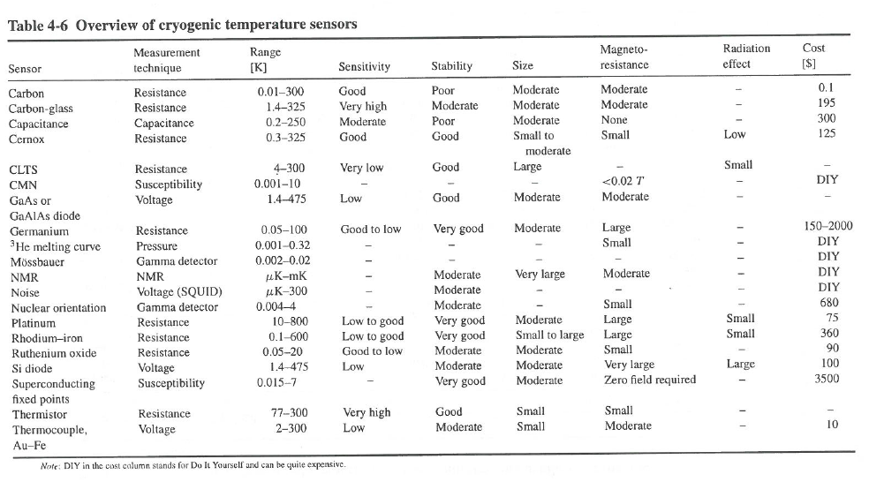
Temperature Sensor Overview
(from Handbook of Cryogenic Engineering)

Slide 9
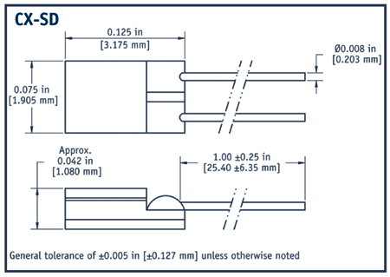
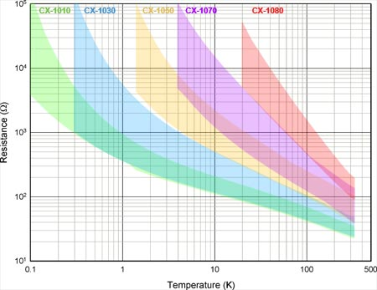
Cernox Temperature Sensors
LakeShore Cryotronics
Very responsive at LHe Temps
Expensive
Requires individual calibration for best results
Very good in ionizing radiation environments

Slide 10
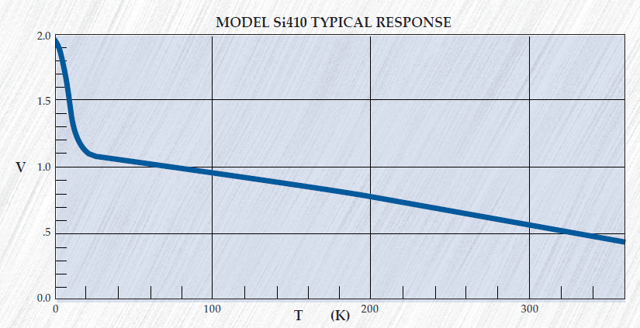
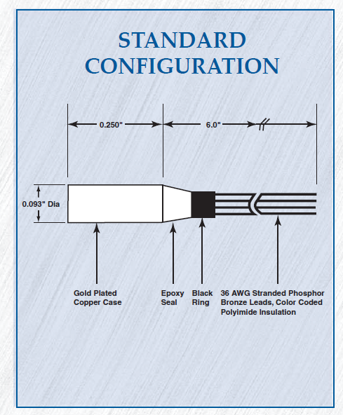
Si410 Silicon Diode
Scientific Instruments
Can both be individually calibrated or used with typical curves
Relatively low cost, frequently used in cryogenic plants
Not suitable for radiation environments

Slide 11
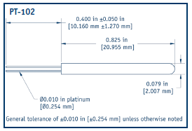
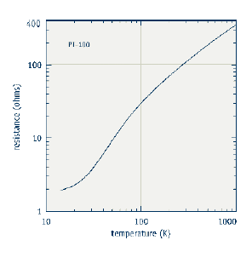
Platinum Resistors
Good down to ~ 30 K
Works well in ionizing radiation fields
Can be calibrated with good accuracy to common calibration curves
Relatively low cost
Excitation is generally 1 mA DC
From Lakeshore Cryotronics Catalog

Slide 12
Temperature Sensor Wiring
Four wire measurements (V+, V-, I+,I-) should be used for temperature sensors to avoid impact of lead resistance on measurement’
Wires should be in twisted pairs (V+,V-) and (I+,I-) to reduce noise pickup
Wires will connect from 300 K to cryogenic temperatures so must be have small cross sections, and low thermal conductivity
  36 gage manganin wire is a frequent choice
    see thermal conductivity integrals
  Avoid using wires that are too fine as this will result in breakage and poor reliability
  Heat sink wires at an intermediate temperature
Don’t over constrain the wires - allow room for movement and shrinkage during cool down to avoid breakage

Slide 13
Heat Sinking of Wires
Critical to the proper use of temperature sensors in vacuum spaces
  You want to measure the temperature of the sensor not that due to heat leak down the wire
  Small heat capacities at cryogenic temperatures means small heat leaks can easily impact sensor temperature
  Heat sink wire at intermediate temperature and also at point where temperature is measured

Slide 14
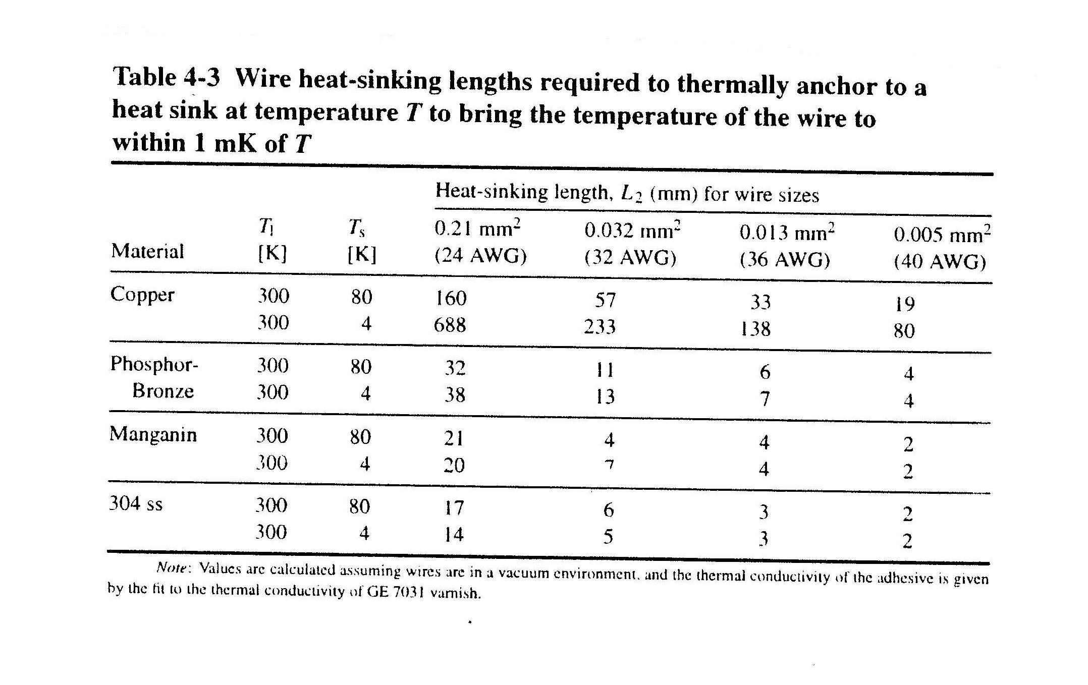
Required Wire Heat Sinking for Proper Temperature Measurement
From “Cryogenic Instrumentation” – D.S. Holmes and S. Courts
Handbook of Cryogenic Engineering

Slide 15
Pressure Measurement
Carry out at room temperature where possible (using a capillary tube)
Problems with room temperature pressure measurement
  Thermal Acoustic Oscillations
  Time response will be too slow for high speed transients but for most operations this isn’t an issues
    High speed pressure pulse due to magnet quenching is an exception
Some cold pressure transducers exist that solve these problems
There are a wide range of 300 K commercial pressure transducers that exist
  Many are based on capacitive sensors or strain gage bridges mounted on diaphragms that change shape with pressure

Slide 16
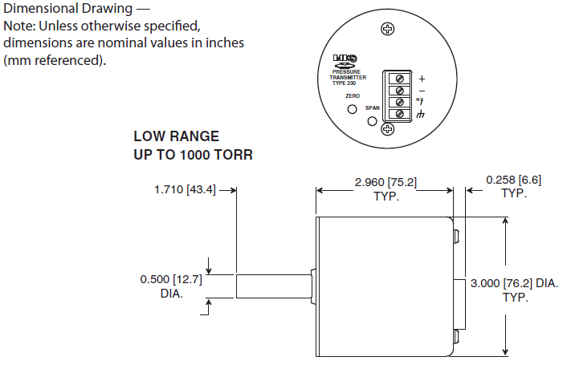
MKS Baratron Pressure Transducer
300 K operation
Uses a capacitive sensor
Accurate up to 0.3 % of reading

Slide 17
Flow Measurements
A variety of techniques are available mostly the same ones as used in standard fluid mechanics including:
  Venturi Meters
  Turbine Flowmeters
  Coriolis Flowmeters
  Orifice plate Flowmeters
Comments
  Insure that the devices are calibrated for operation at the temperatures and pressures that you are expecting (use appropriate fluid properties)
  Beware of situations that can result in unplanned two-phase flow
  Allow sufficient length for flow straightening if required (e.g. Venturi)
  If possible install the flow meters in the 300 K portions of the flow

Slide 18
Venturi Flow Meter
Note use of cold DP transducer
A more common approach is to use capillary tubes and a warm transducer
From The Handbook of Cryogenic Engineering

Slide 19
Coriolis Flow Meter
Tested down to 1.7 K at CERN LHC
Flow produces vibrations in the flow tubes that have a phase offset directly related to mass flow
From Development of a mass flowmeter based on the Coriolis acceleration
for liquid, supercritical and superfluid helium
de Jonge T. et al. Adv. Cryo. Engr. Vol 39 (1994)

Slide 20
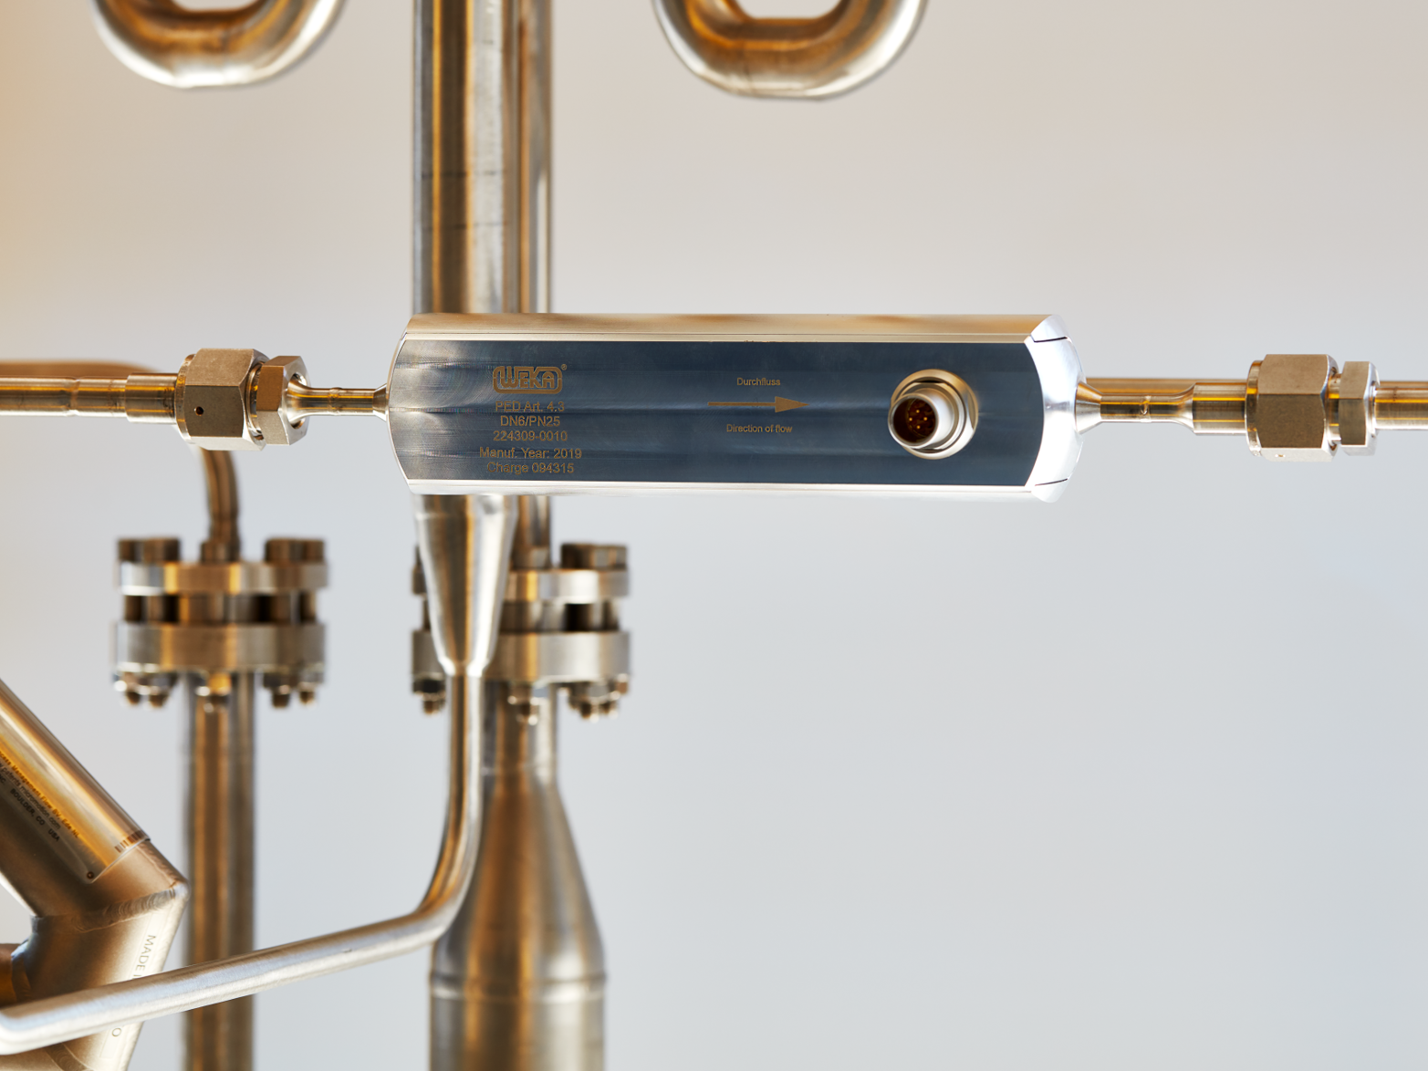
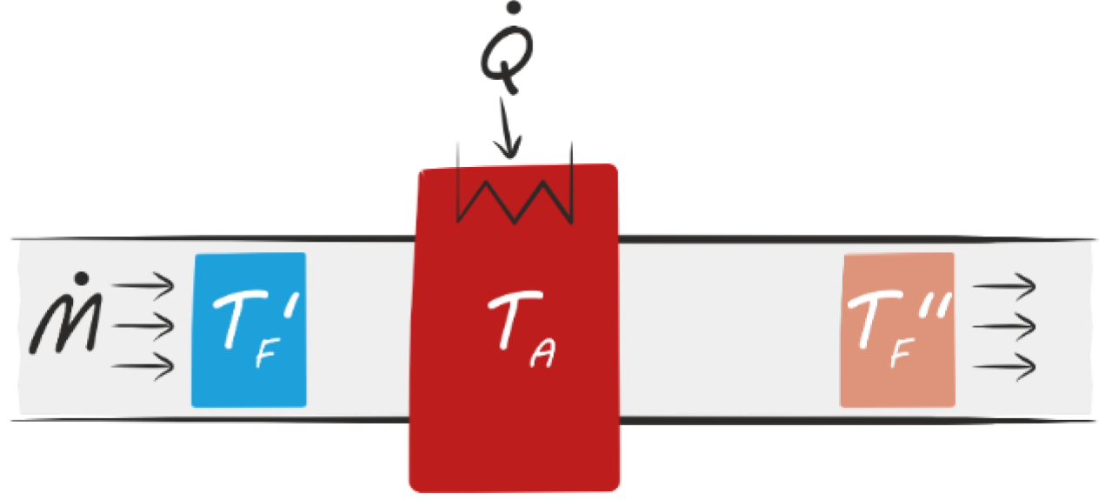
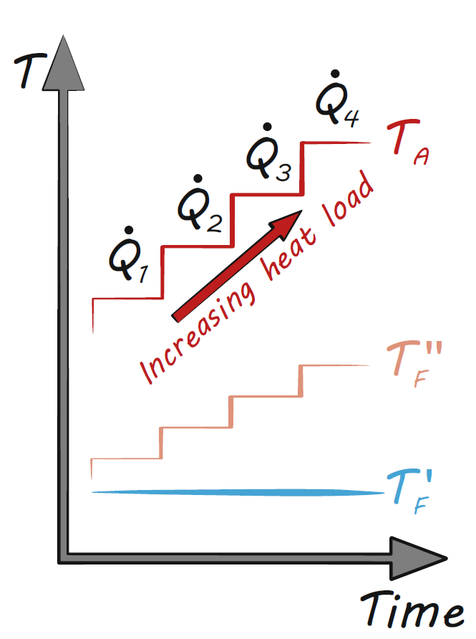
^{WEKA}SENSE® Flow Meter
Thermal
measuring principle
In situ calibration under real operating conditions
Very high accuracy
Very small operating losses
  pressure drop
  temperature increase
Minimum space requirement
Easy installation and commissioning
Integrated temperature measurement
New to the market in 2019
Automatic
Self-calibration:

Slide 21
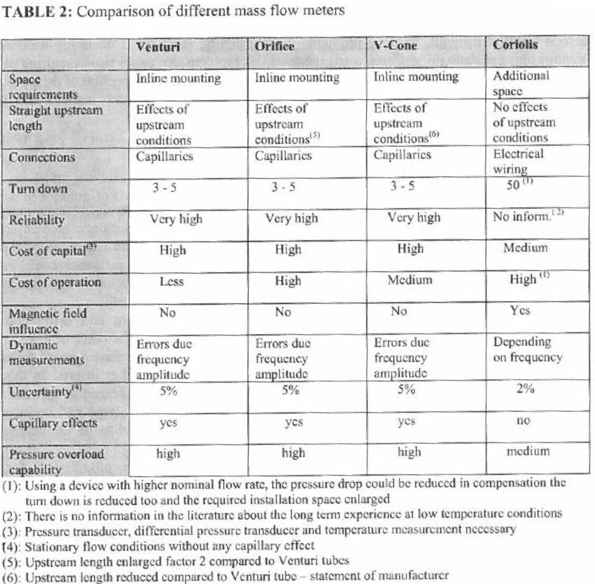
^{WEKA}SENSE®
inline mounting, very little space required
No effects of upstream conditions
Electrical wiring
60
No inform.
High
Low
No
Depending on freqency
1 %
no
high
Data From WEKA

Slide 22
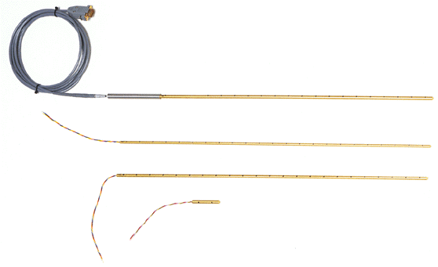
Level Measurements
Measuring the level of cryogenic baths is important to proper operations
Options include:
  Capacitance gauges (LN₂, LOX, LH₂)
  Superconducting level probes (LHe)
    Installing redundant or easily replaceable s/c level probes is highly recommended
  Differential pressure techniques
  Floats (LN₂)
S/C Liquid level probes
American Magnetics Inc

Slide 23
Feedthroughs
Instrumentation feedthroughs are best done at 300 K
Avoid cryogenic instrumentation feedthroughs if at all possible
  If you can’t, significant testing and validation will be needed
In test and prototype cryostats always put in more feedthroughs (or blank flanges) than you think you’ll need
GHe at 300 K and 1 bar has poor dielectric strength use spacing of pins or potting of feedthrough if this will cause problems (e.g. in voltage taps of S/C magnets)
Beware of possible thermal acoustic oscillations being set up in pressure taps and other sealed tubes

Slide 24
Thermal Acoustic Oscillations (TAOs)
Occurs in a tube that connects room temperature and cryogenic temperatures and is sealed at the room temperature end
The thermal gradient establishes standing pressure oscillations in the fluid in the tube.
These oscillations can cause very high pressure spikes as well significant heating at the low temperature end due to friction.
This can cause significant problems in cryogenic systems
Such scenarios should be avoided but the enabling geometry is fairly common in cryogenic systems
  Valved off lines
  Pressure taps
  Instrumentation
There have been studies to determine stable (non-oscillating geometries)

Slide 25
Stability Curves for TAOs in He
α
α
ξ = 1
ξ = 1
Y. Gu
PhD Thesis
University of Colorado 1993

Slide 26
Using the Stability Curves
Where the division between L_{H} and L_{C} is the point in the tube
where T = (T_{H} + T_{C})/2
These curves are for a 1 meter long tube. To use them with other lengths use the
Adjusted radius:
Stability on the left hand side of the plots is due to viscous damping
and stability on the right hand side of the plots is due to inertial damping

Slide 27
Other Approaches to Removing TAOs
Add volume to the warm end
Install a check valve between the warm and cold end (near boundary between the two) – this converts the problem to a closed cold tube with no TAOs
Heat sink the closed end ( thus changing T_{H}/T_{C})
Allow flow through the warm end

Slide 28
TAO Example at ESS
The first cooldown of the ESS Cryogenic Distribution System (CDS) showed the presence of TAOs in a number of valve assemblies.
These greatly added to the heat leak of the system
A systematic approach to reducing these TAOs via adding barriers and anding a small volume to the end box has greatly reduced the effect of the TAOs and likely has brought the heat leak of the CDS to acceptable values.

Slide 29
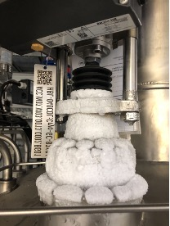
TAO Example at ESS
Example of an ice ball at the top of a control valve in a ESS CDS Valve box. This results from a TAO in the gap between the valve body and insert
Courtesy J. Fydrych - ESS

Slide 30
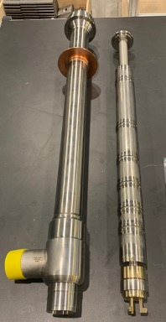
TAO Example at ESS
Courtesy J. Fydrych - ESS
Convection breaks installed in the annualar space of the ESS control valves. Early (June 2023) data shows that this fix has greatly reduced the TAOs and subsequent heat load in these valves

Slide 31
TAO Example at ESS
Use of buffer tank to reduce
TAO in safety valve
Courtesy J. Fydrych - ESS

Slide 32
Commercial Sources of Cryogenic Instrumentation
Don’t reinvent the wheel – there is a lot already available. Catalogs can help you choose the correct sensor for your application
Two US Sources:
  Lakeshore Cryogenics
  http://www.lakeshore.com/
  Scientific Instruments
  http://www.scientificinstruments.com/
Possible Cold Pressure Transducers
  http://www.omega.com/
  http://www.gp50.com/
Cryogenic Society of America Buyer’s Guide
  http://www.cryogenicsociety.org/buyers_guide/

